Slide 1
3 Phase 2 Furious

Slide 2
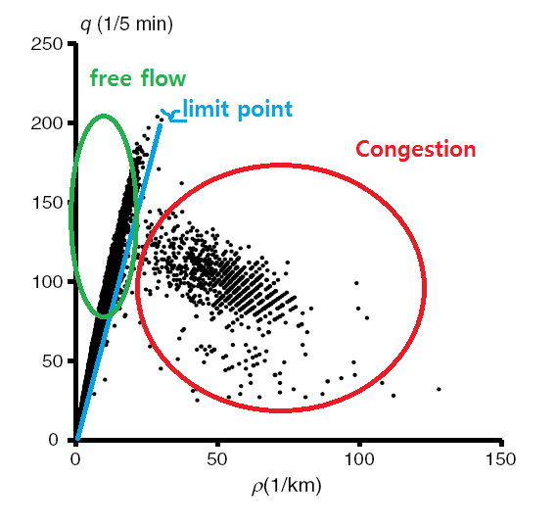
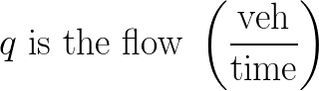
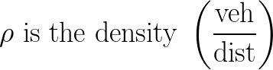
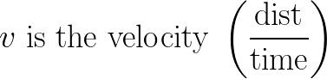
[1]
Notes:
“it is sufficient to provide only three parameters for understanding the empirical features of three phases: Velocity (v), density (p) and flow rate (q) of vehicles.” [1]
“when density reaches maximum density for the free flow (aka 'limit point'), a transition to congestion must occur” [1]
larger variance in points within congestion (synchronized flow)
wide moving jam has linear relationship ('J' line)

Slide 3
Phase Characteristics
 | Speed | Flow rate | Density
Free flow | High | High | Low
Synchronized flow | Low | Close to free flow | Middle
Wide moving jam | ignorable | ignorable | Highest
[1]

Slide 4
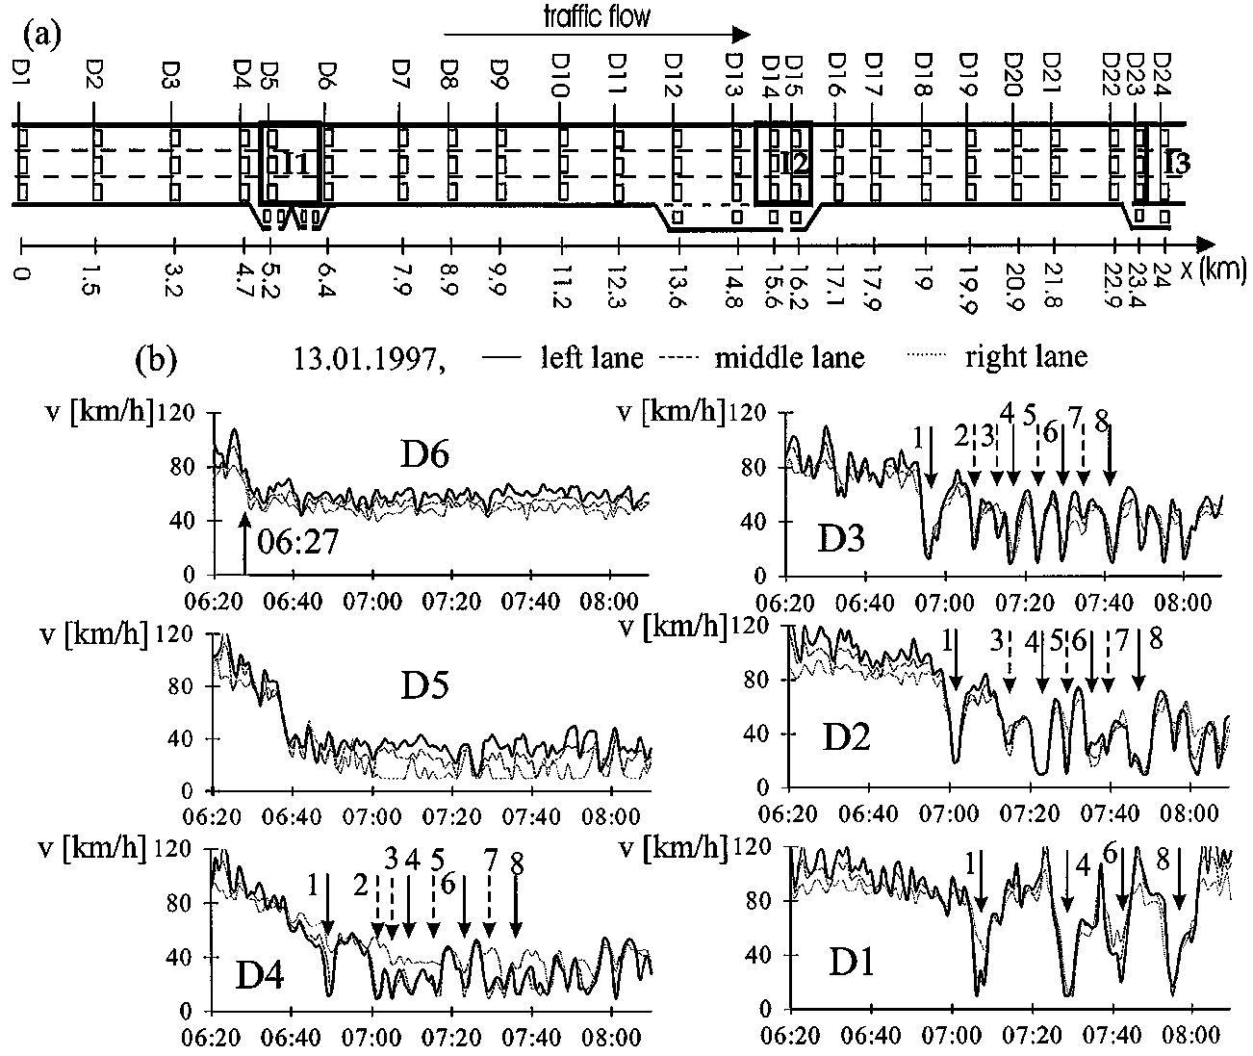
[2]
Notes:
transitions to synchronized flow (D6-D4, ~06:27), narrow jams grow and/or dampen (D4-D1)

Slide 5
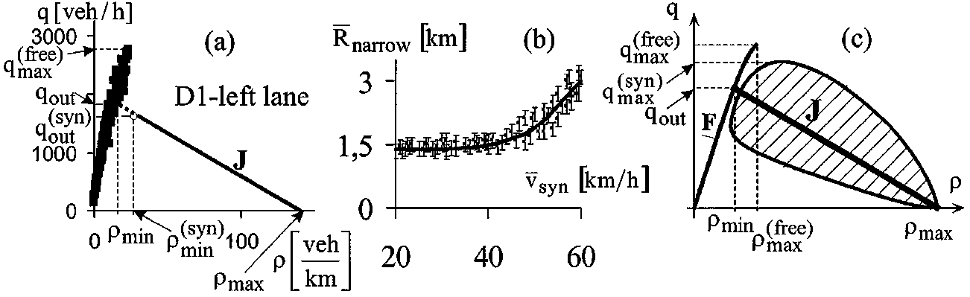
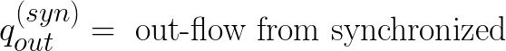
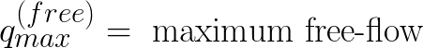
[2]
Notes:
Figure (a) - derived from that data of previous slide, in fig b, D1 at downward arrow 1
Figure (c) - hatched region around J-line represents synchronized flow
“the downstream fronts of the jams may be represented in the flow-density plane (fundamental diagram) by the characteristic line J”
“the left coordinate of the line J is approximately related to the point (p_{min}^{syn}, q_{out}^{syn})”

Slide 6
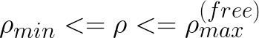
(Metastable for free-flow)
Metastable
Wide-moving jams cannot form
[2]
Notes:
(i) the line J determines the threshold of the jam’s existence and
(ii) the line J separates all homogeneous states of both free and synchronized flow into two qualitatively different classes:
(1) In states which are related to points in the flow-density plane lying below the line J no jams can be excited or exist, and
(2) states which are related to points in the flow-density plane lying on and above the line J are “metastable” states.

Slide 7
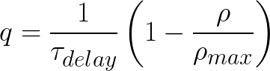
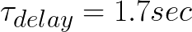
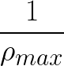
The Line J Equation
In the diagrams above, the estimated
The average distance between vehicles in a jam (headway)
[1,2]

Slide 8
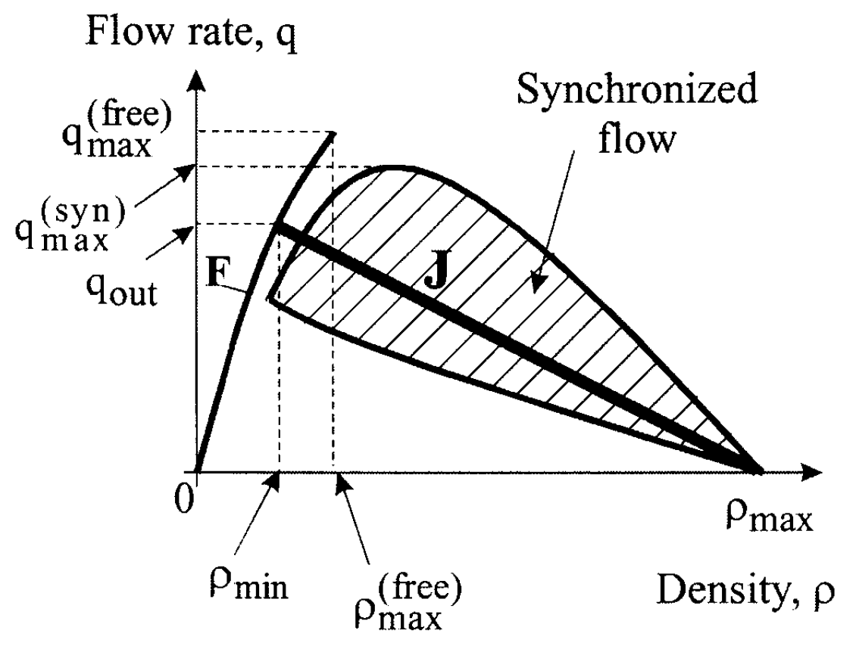
The Line J
points on the fundamental diagram lying below the line J, cannot be excited into jam state nor can they continue to exist in a jam state
points on the fundamental diagram lying above the line J are metastable states.
metastable states can be induced to transition if a local perturbation amplitude exceeds some critical amplitude
this critical amplitude is maximal at the line J (and it considerably lower in synch flow than free flow)

Slide 9
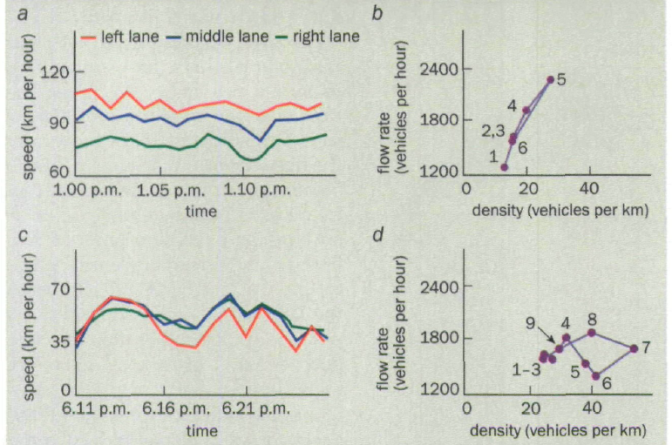
Free-flow
Synchronized
[3]
Notes:
(a) “If the vehicle density is low enough (ie. "free flow") [...] the average vehicle speed may be different for each lane.”
(c) “If the density is high enough, the flow becomes congested (avg speed is the same for all lanes)”
(b) “In free flow an increase in the vehicle density is also accompanied by an increase in die flow rate, and vice versa.”
(d) “In synchronized flow, however, changes in the flow rate and the density can be totally non-correlated. An increase in the vehicle density can be accompanied by either an increase or by a decrease in the flow rate”

Slide 10
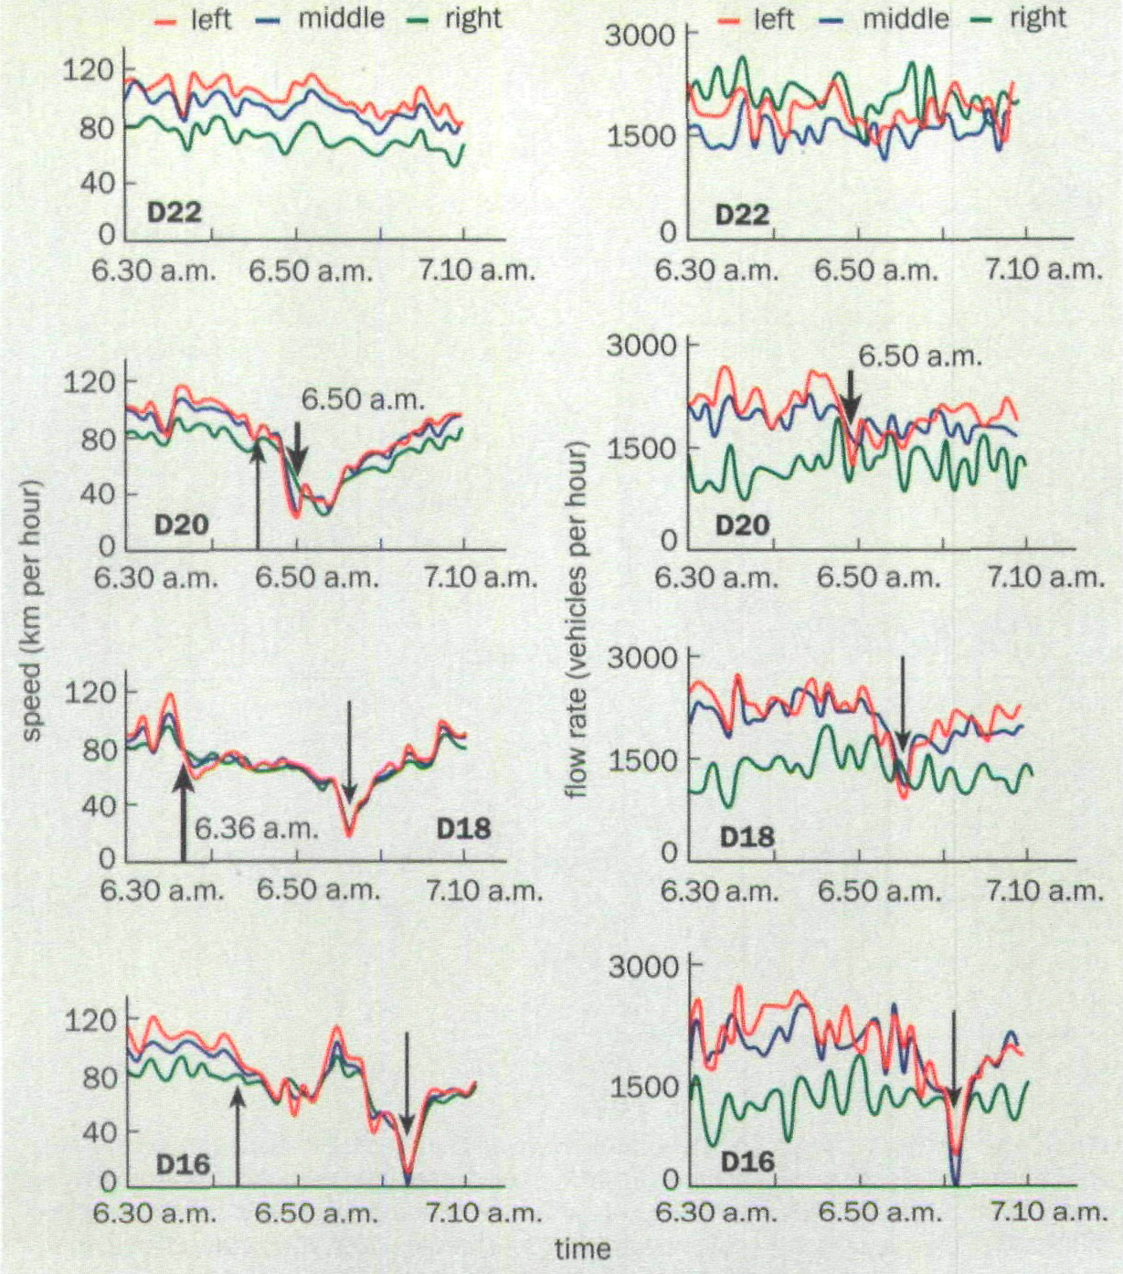
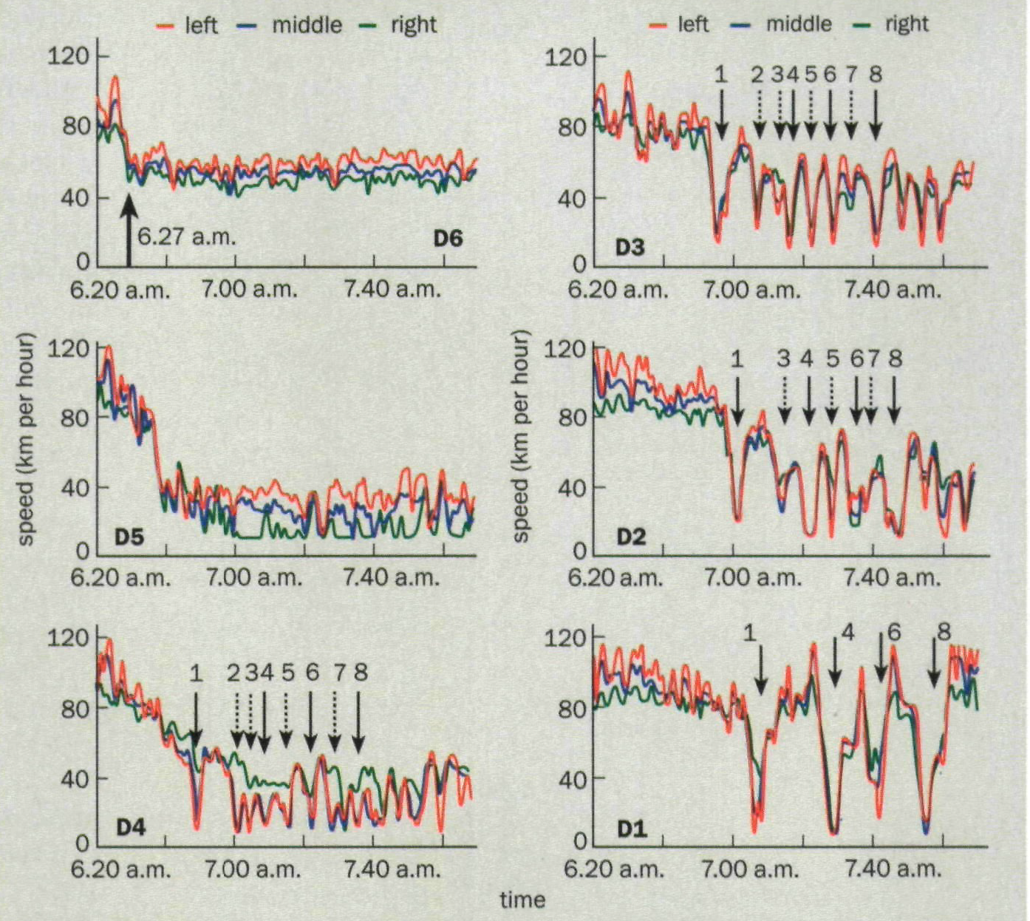
(a)
(b)
[3]
Notes:
Flow may remain the same between free and synchronized states
Flow drops (along with speed) in a jam
Bottlenecks
D22, left and right graphs, free-flow
D18 (left graph), 6:36am F->S transition at up arrow, (right graph) flow does not change
D16/D20 (left graph), synch transition propagates upstream and downstream at up arrows
D20 (left graph), 6:50am S->J transition at down arrow
D18/D16 (left graph), jam propagates upstream at down arrows
Stop’n’go
D6, 6:27am F->S transition at up arrow
D5-D1, synch state propagates upstream
D4-D1, narrow jams (stop and go) propagate upstream

Slide 11
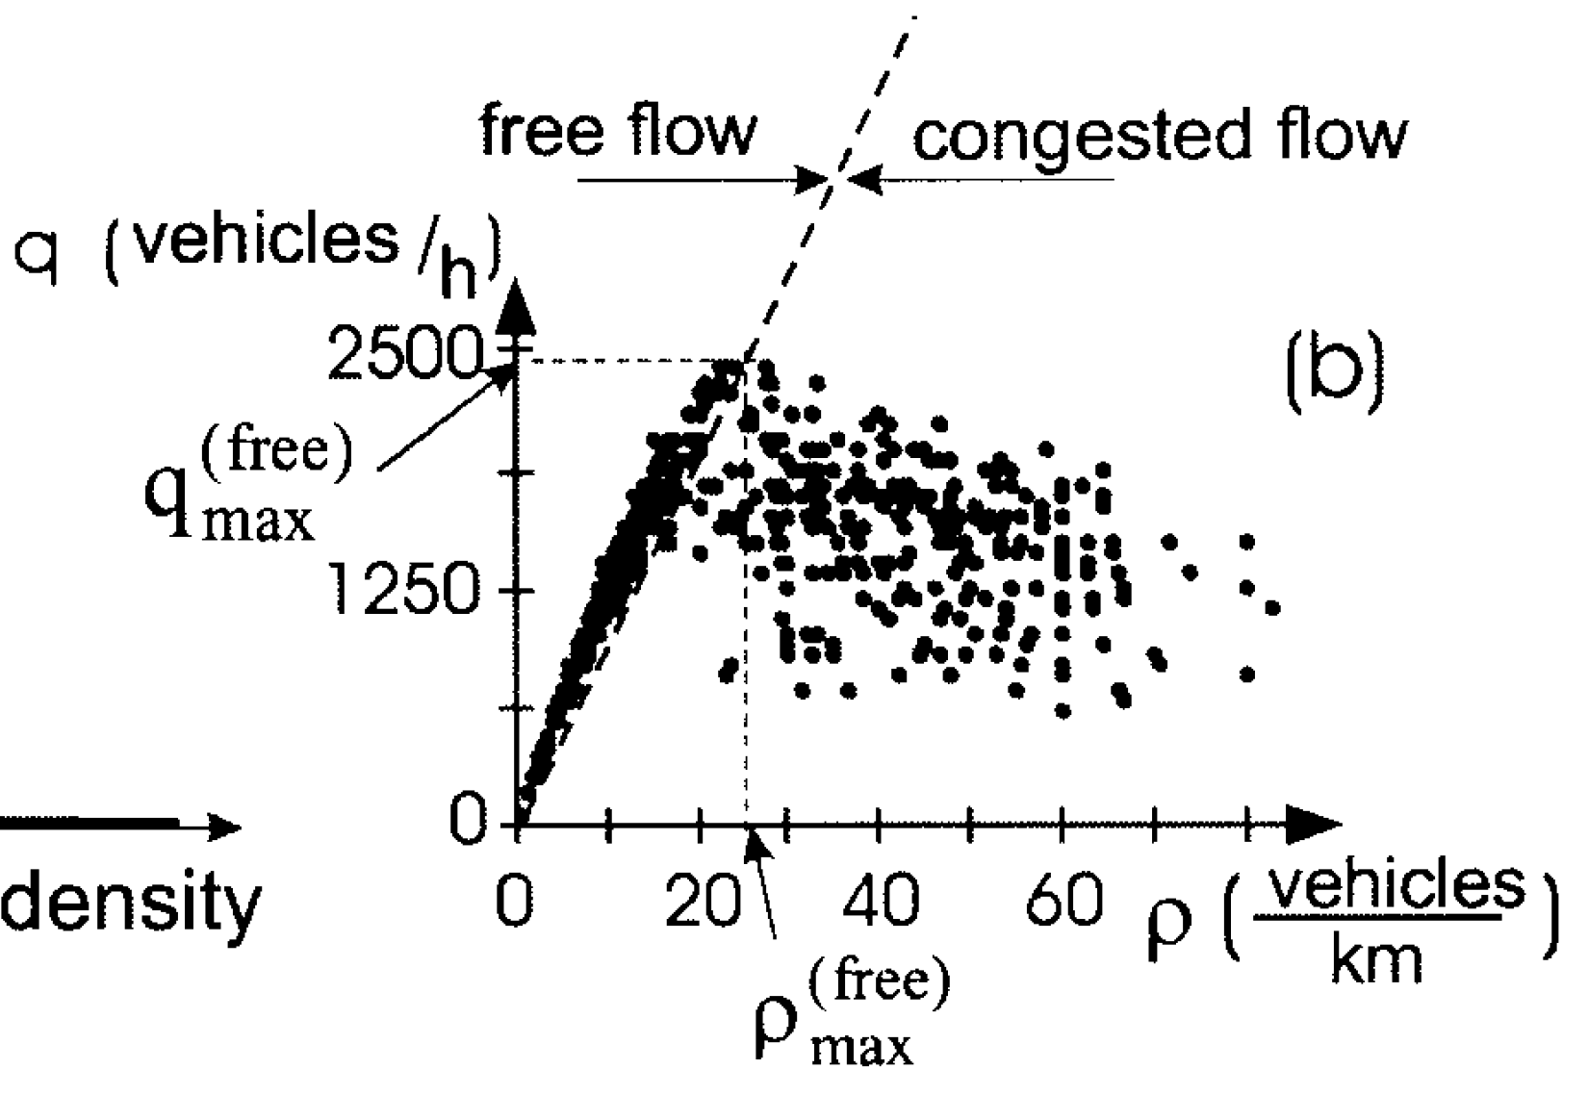
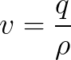
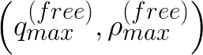
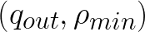
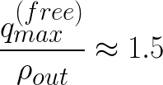
limit point
[4]
Notes:
Congested traffic [occurs] where the average vehicle speed (v) is lower than the minimum possible speed, which is related to the limit point (q_{max}^{free}, p_{max}^{free})
Flow rate out from a jam is about 2/3 the max of free flow

Slide 12
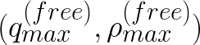
Free → Jam Transition
𝜌_{min} determines the threshold density for jam formation
jams cannot form at densities below 𝜌_{min}
above 𝜌_{min}, free flow is metastable
F→J only occurs if the synchronized phase is somehow hindered
critical amplitude of a F→J transition is zero at the max density point in free flow
however, F→S transition occurs at lower density, so an F→J transition does not occur in real traffic
[3]

Slide 13
Free → Synchronized Transition
vehicle speed (𝑣) decreases, density (𝜌) increases
the flow rate (𝑞) can remain almost as high as an initial free flow
downstream front
fixed at a bottleneck (ie. onramp)
separates free flow (upstream) from synch flow (downstream)
upstream front
propagates further upstream
separates synch flow (upstream) from free flow (downstream)
occurs randomly, or induced by downstream jam/synchronized flow which is propagating upstream
out-flow rate (downstream) from a synch flow can vary widely
[3]

Slide 14
Narrow vs. wide jams
narrow jam outflow depends on the inflow, wide jam outflow does not
no characteristic parameters (or J line) for narrow jams (ie. velocity of downstream front is not constant and it usually higher than for a wide jam)
narrow jams cannot propagate through all traffic states, wide jams can
narrow jams are effectively a type of wave within synch. traffic
[3]

Slide 15
Pinch Effect
[2] “synchronized flow and the pinch effect, which triggers off the self-formation of stop-and-go patterns, occur considerably more frequently in the vicinity of on-ramps, off-ramps, and other freeway bottlenecks”
[6] “the 'pinch effect' occurs if synch flow has high density and low speed. moving jams are likely to occur within pinch effected synch flows.”

Slide 16
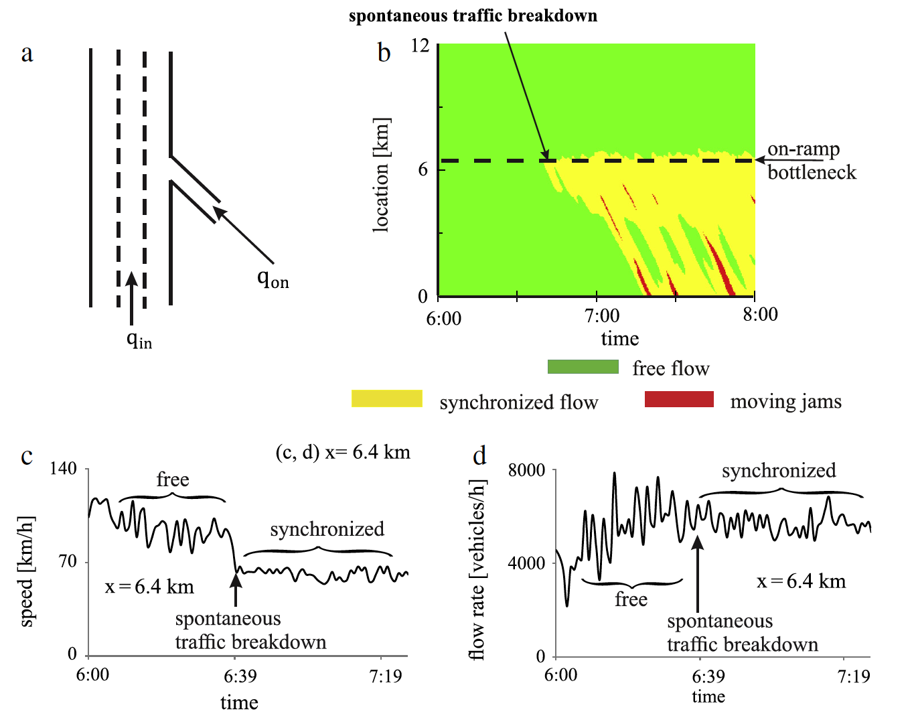
Spontaneous traffic breakdown
[6]
Notes:
Empirical features of spontaneous traffic breakdown (spontaneous F→S transition) at on-ramp bottleneck.

Slide 17
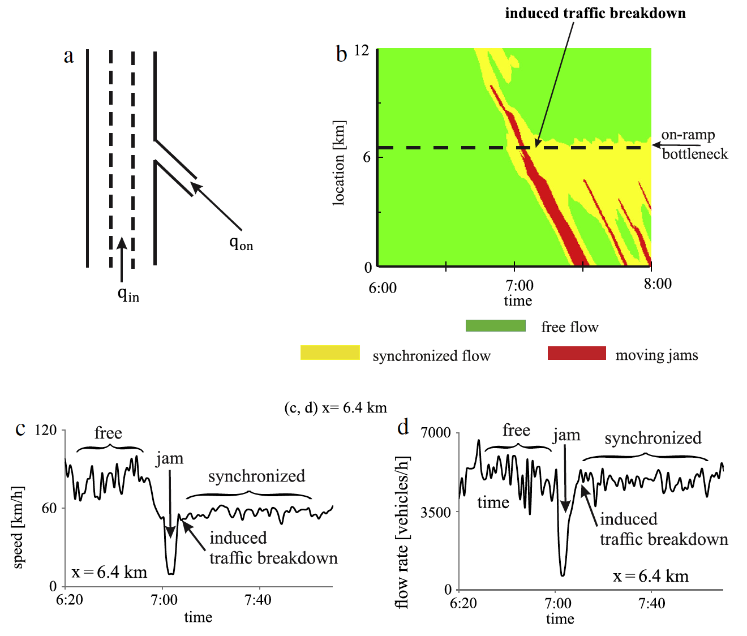
Induced traffic breakdown
[6]
Notes:
Empirical features of induced traffic breakdown (induced F→S transition) at on-ramp bottleneck.

Slide 18
References
[1] Three phase traffic theory M. Park, 2012
[2] Experimental Features of Self-Organization in Traffic Flow B. Kerner, 1998
[3] The physics of traffic B. Kerner, 1999
[4] Complexity of Synchronized Flow and Related Problems for Basic Assumptions of Traffic Flow Theories B. Kerner, 2001
[5] A microscopic model for phase transitions in traffic flow B. Kerner and S. Klenov, 2002
[6] Failure of classical traffic flow theories: Stochastic highway capacity and automatic driving B. Kerner, 2015

